Slide 1
Welcome to our Presentation

Slide 2
Presentation Topic
Inverse Laplace Transform Properties
Presented By:
1. Meheniger Alam (11909035)
2. Md. Mehadi Hasan (11909007)
3. Gargi Roy Tushi (11909016)
4. Jewel Nath (11909037)
5. Tamanna Akter (11909020)
Dept. of ICT
Comilla university
Presented to:
Dr. Md. Ghulam Murtaza Talukder,
Associate Professor,
Department of Mathematics,
Comilla University.

Slide 3
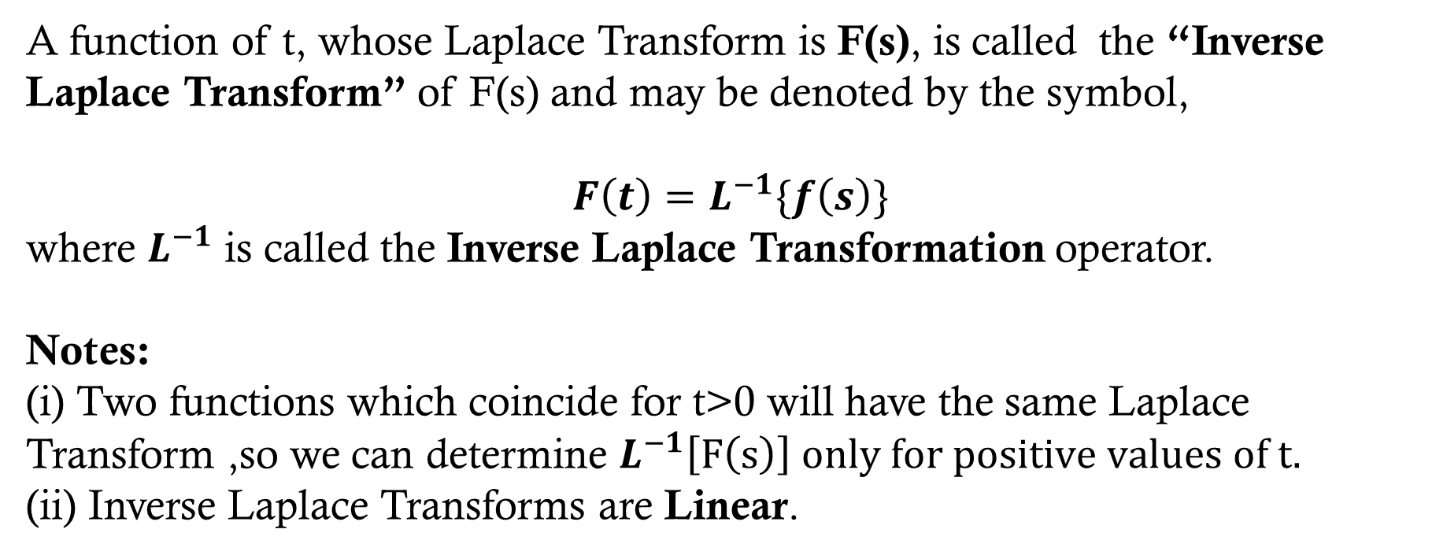
Dfinition of Inverse Laplace Transform
A function of t, whose Laplace Transform is F(s), is called the “Inverse Laplace Transform” of F(s) and may be denoted by the symbol,
$$F\left(t\right)=L^{−1}\{f\left(s\right)\}$$
where $L^{−1}$ is called the Inverse Laplace Transformation operator.
Notes:
(i) Two functions which coincide for t>0 will have the same Laplace Transform ,so we can determine $L^{−1}\left[F\left(s\right)\right] only for positive values of t.$
(ii) Inverse Laplace Transforms are Linear.

Slide 4


Properties of Inverse Laplace Transforms
1. Linearity Property:
If c1 and c2 are any constants while $f1\left(s\right)and f2\left(s\right)$are the Laplace Transforms of F1(t) and F2(t) respectively, then
$L^{−1}\{$c1 $f$1(s) + c2 $f$2(s) } = c1$L^{−1}\{f$1(s) } + c2 $L^{−1}\{f$2(s) }
= c1 F1(t) + c2F2(t)
Example:
$$\begin{aligned} ℒ^{−1}\left\{\frac{4}{s−2}−\frac{3s}{s^{2}+16}+\frac{5}{s^{2}+4}\right\}=4ℒ^{−1}\left\{\frac{1}{s−2}\}−3L^{−1}\left\{\frac{s}{s^{2}+16}\right\}+5ℒ^{−1}\left\{\frac{1}{s^{2}+4}\right\}\right\} \\ =4e^{2t}−3cos\left(4t\right)+\frac{5}{2}sin\left(2t\right) [Ans.]\end{aligned}$$

Slide 5


2. First Translation or Shifting property:
If $L^{−1}\{ f$(s)} = F(t), then
$L^{−1}\{f$(s - a)} = $e^{at}F(t)$
$$\begin{aligned}Sinceℒ^{−1}\left\{\frac{1}{s^{2}+4}\right\}=\frac{1}{2}sin\left(2t\right), \\ we have \\ ℒ^{−1}\left\{\frac{1}{s^{2}−2s+5}\right\}=ℒ^{−1}\left\{\frac{1}{{\left(s−1\right)}^{2}+4}\right\}=\frac{1}{2}e^{t}sin\left(2t\right)\end{aligned}$$
Example:

Slide 6

3.Change of scale property:
If $L^{−1}\{f$(s) } = F(t) , then $L^{−1}\{f$(ks) } = $\frac{1}{k}F(\frac{t}{k})$
f(t)
f(kt)
Area reduced
by factor k
-k
k
-1
1
Example:
$$\begin{aligned}Sinceℒ^{−1}\left\{\frac{s}{s^{2}+16}\right\}=cos\left(4t\right), \\ wehave, \\ ℒ^{−1}\left\{\frac{2s}{{\left(2s\right)}^{2}+16}\right\}=\frac{1}{2}cos\left(\frac{4t}{2}\right)=\frac{1}{2}cos\left(2t\right)\end{aligned}$$

Slide 7


4.Inverse Laplace Transform of Derivatives:
If $L^{−1}${f(s)} = F(t),
Then,
$L^{−1}${$f^{\left(n\right)}(s)\}=L^{−1}${$\frac{d^{n}}{ds^{n}}f$(s)} = ${\left(−1\right)}^{n}t^{n}F(t)$
Example:
$$\begin{aligned}Sinceℒ^{−1}\left\{\frac{1}{s^{2}+1}\right\}=sin\left(t\right),\frac{d}{ds}\left(\frac{1}{s^{2}+1}\right)=\frac{−2s}{{\left(s^{2}+1\right)}^{2}},wehave \\ ℒ^{−1}\left\{\frac{−2s}{{\left(s^{2}+1\right)}^{2}}\right\}=−tsin\left(t\right) \\ ℒ^{−1}\left\{\frac{s}{{\left(s^{2}+1\right)}^{2}}\right\}=\frac{1}{2}t.sin\left(t\right)\end{aligned}$$

Slide 8


5. Inverse Laplace Transform of Integrals:
If $L^{−1}${f(s)} = F(t) , then
$L^{−1}\{\int_{s}^{∞}{f\left(u\right)du\}}$= $\frac{F(t)}{t}$
$$\begin{aligned}Sinceℒ^{−1}\left\{\frac{1}{s\left(s+1\right)}\right\}=ℒ^{−1}\left\{\frac{1}{2}−\frac{1}{s+1}\right\}=1−e^{−t},wehave \\ ℒ^{−1}\left\{\int_{s}^{∞}{\left(\frac{1}{u}−\frac{1}{u+1}\right)}du\right\}=ℒ^{−1}\left\{ln\left(1+\frac{1}{s}\right)\right\}=\frac{1−e^{−t}}{t}\end{aligned}$$
Example:

Slide 9
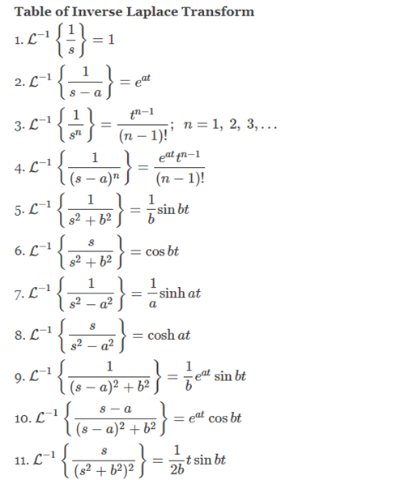

Slide 10
Thank You
Everyone.

